Slide 1
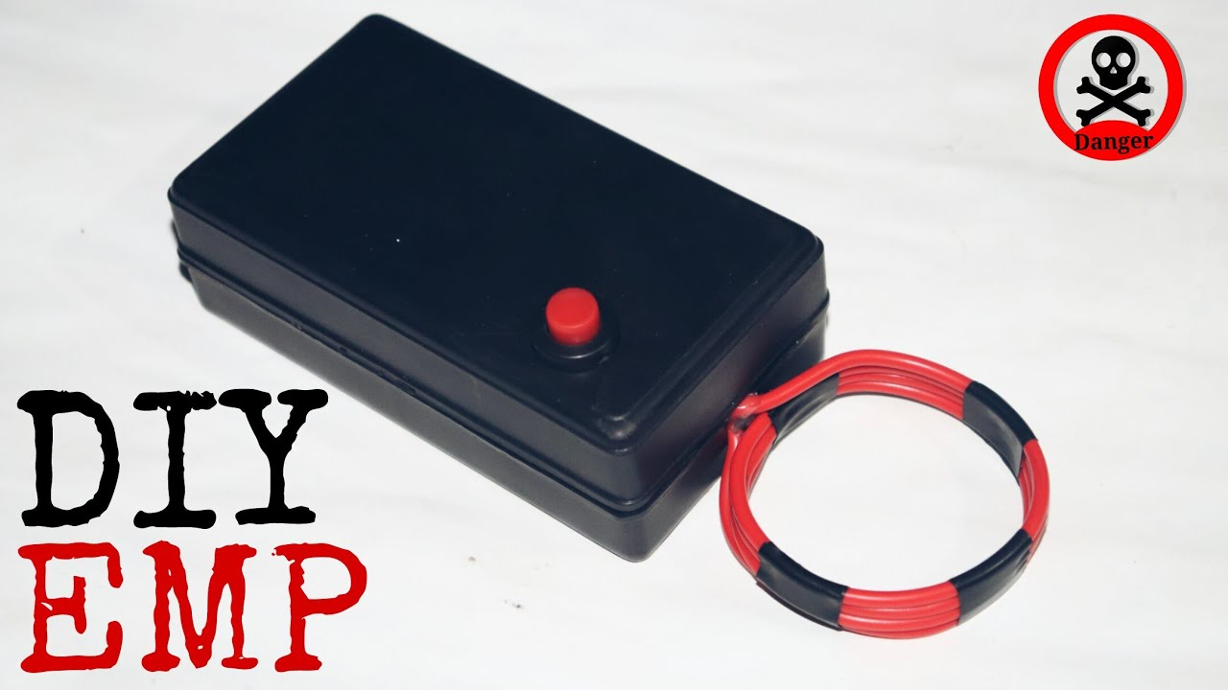
Topic:
EMP JAMMER

Slide 2
What is emp Jammer ?
An EMP jammer(Electromagnetic Pulse jammer) is a device that emits a strong burst of electromagnetic radiation in the form of an electromagnetic pulse (EMP).
The purpose of such a device is typically to disrupt, damage, or disable electronic equipment, especially those with sensitive or vulnerable electronic components.
These pulses can overload and damage the electronic circuitry of the affected devices, rendering them inoperable.

Slide 3
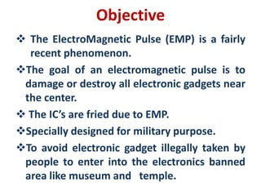
.

Slide 4
.HOW DOES IT WORK ?
There are many methods to produce an emp. We will use the spark gap method
A high voltage generator is connected in series with a spark gap(2mm or less) and a coil of wire.
As the circuit is turned on, Voltage begins to build up at the Spark gap
When the voltage is high enough It jumps across the spark gap and hence current flows through the circuit
The current flowing through the conductor generates the magnetic field around the conductor.
If current is supplied with intervals it generates high magnetic field pulses on the conductor, the field increases suddenly and decreases.
These high-intensity pulses induce a back emf in the devices which in turn damages the device.

Slide 5
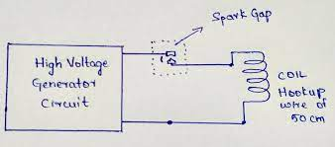
Working circuit

Slide 6
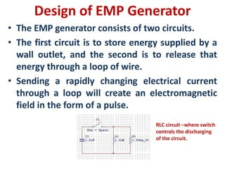
.

Slide 7
PULSE Vs CONTINUouS WAVE
We use a pulse over a continuous wave due to the following reasons
Rapid Disruption: EMP pulses have rapid rise times, meaning that the electromagnetic energy is released in an extremely short duration. This rapid change in the electric field can induce high currents and voltages in electronic components
Broadband Effects: The sharp edges of EMP pulses generate a wide spectrum of electromagnetic frequencies. This broad frequency range increases the likelihood of affecting a wide variety of electronic devices and systems
Enhanced Energy Concentration: EMP pulses concentrate a significant amount of electromagnetic energy into a short time frame, resulting in a higher energy density.
Tailored Disruption: EMP generators can be designed to produce pulses with specific characteristics, allowing for customization based on the intended target.
Energy Efficiency: Generating a continuous wave requires a continuous source of energy, which can be impractical and energy-intensive. EMP pulses are more energy-efficient since they release energy in short bursts

Slide 8
PROTECTING AGAINST AN EMP
The following methods can be used to protect against an EMP attack
Shielding: The primary method for protecting against EMP is to use shielding materials to block or divert the electromagnetic radiation. This can include Faraday cages, which are enclosures made of conductive materials like metal.
Hardening: Hardening techniques can include using special EMP-resistant components, adding surge protectors and filters, and implementing redundancy in critical systems.
Isolation: Isolating electronic systems from EMP sources can help protect them. This might involve physically distancing critical systems from potential EMP sources, using concrete to block radiation etc.
Redundancy: Implementing redundancy in critical systems can be a valuable strategy. If one system fails due to an EMP, a redundant system can take over.
EMP Filters: EMP filters can be added to power lines and communication cables to block EMP-induced currents from entering sensitive equipment.

Slide 9
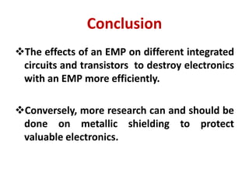
.

Slide 10


